Slide 1
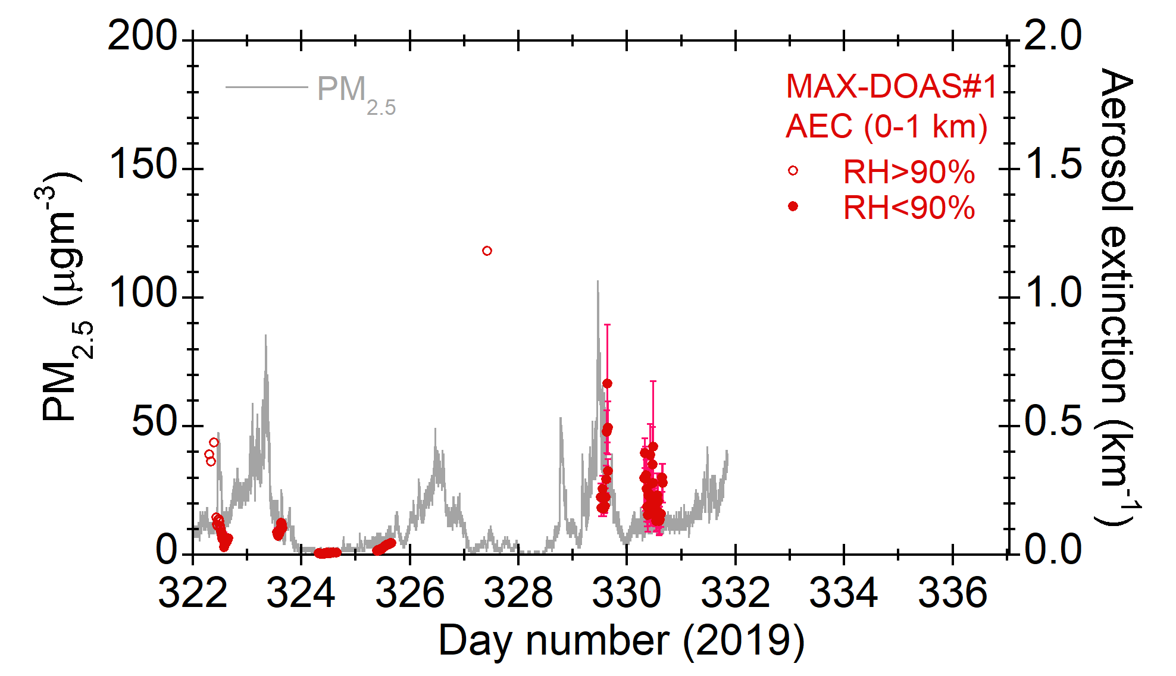
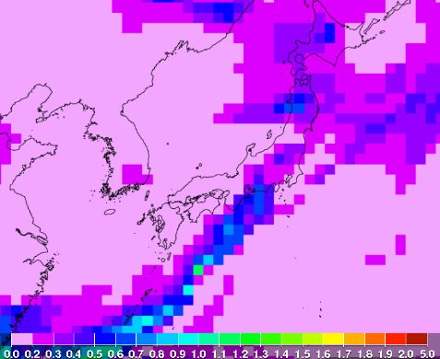
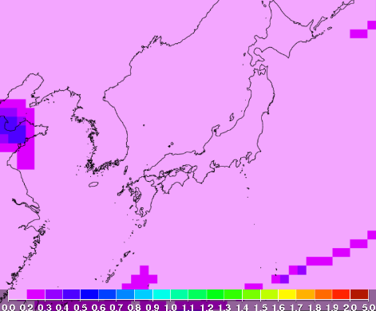
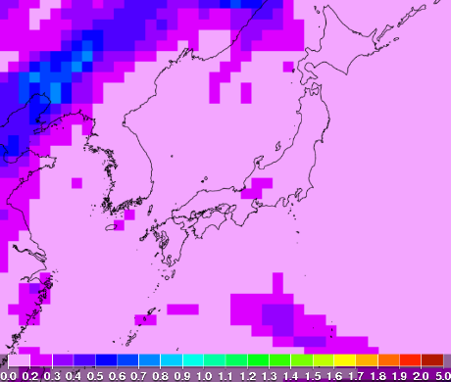
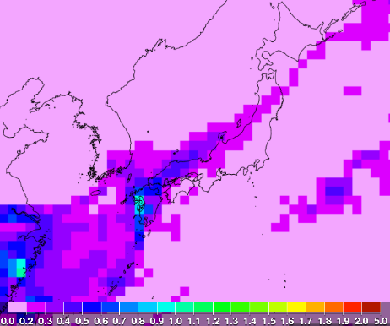
PM2.5 vs. MAX-DOAS AEC vs. MASINGAR AOT
https://www.eorc.jaxa.jp/ptree/index_j.html
Nov. 19 3:00 JST
Nov. 20 12:00 JST
Nov. 22 12:00 JST
Nov. 25 12:00 JST
It seems that cold front with China’s air pollution brought high PM_{2.5} events (Nov. 19, 25).
High PM_{2.5} event on Nov. 22 was not calculated by MASINGAR model.

Slide 2
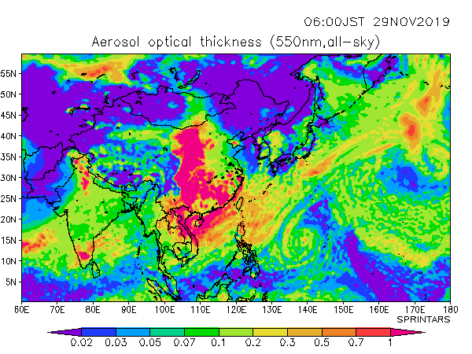
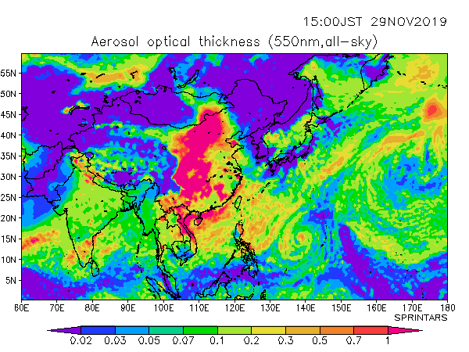
Prediction of AOT by SPRINTARS for 20191129
Nov. 29 9:00 JST
Nov. 29 15:00 JST
SPRINTARS model calculated that AOT550 around Chiba would be around 0.1-0.2 in the morning and decrease in the afternoon.

